Slide 1


The Ideal Intranet Project Team Handbook
Visit: www.bonzai-intranet.com
Email: stressfree@bonzai-intranet.com

Slide 2




Introduction
We’ve created this Handbook as a handout from part 2 of our 12-part Intranet Success Webinar Series – “The Ideal Intranet Project Team”. We want to help you to create the ideal project team for your intranet project success.
The 12-part webinar series covers the following topics, as we share stories from our experience spanning many years of implementing successful intranets.
http://bonzai-intranet.com/

Slide 3
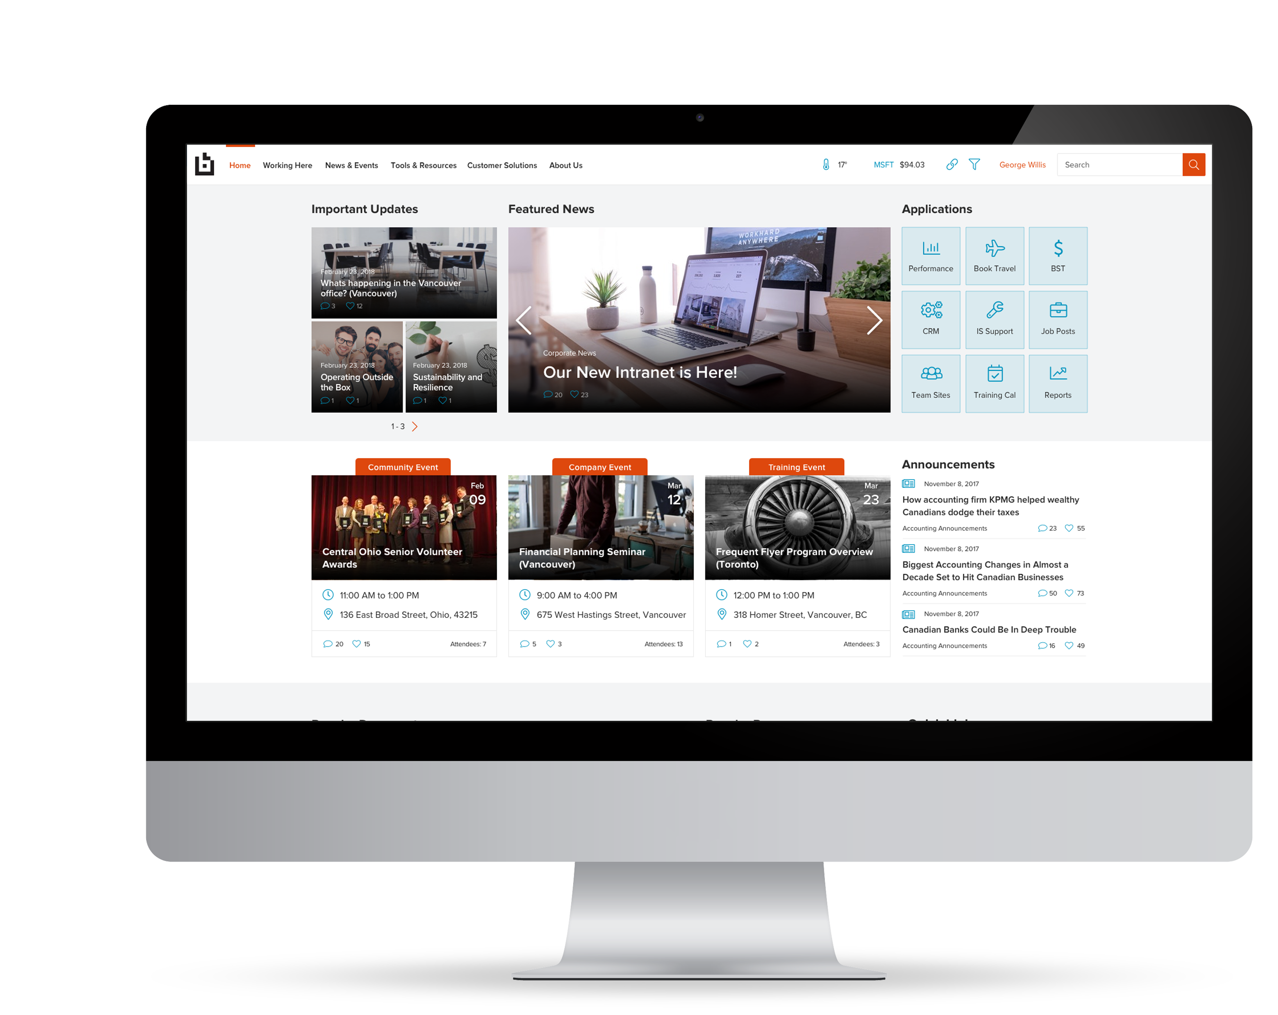
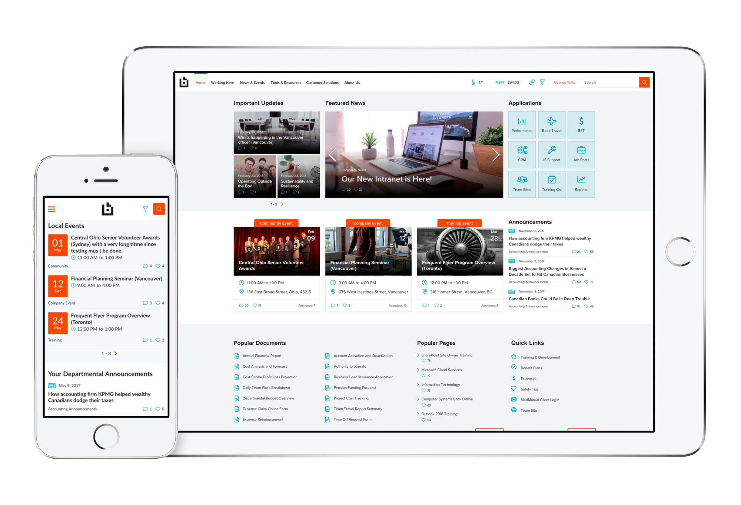
The Webinar Series Covers the Following:
How to Create an Award-Winning Intranet in 2018:
What Makes a Great Intranet & How You Can Create One
Your Intranet Project Team:
Defining the Ideal Intranet Project Team
Intranet Content Planning (Part I):
Understanding Your Intranet Content with Content Auditing
Intranet Content Planning (Part II):
Content Mapping, Content Ownership & Content Reviews
Organizational & User Requirements:
How to Best Gather Requirements for Your New Intranet
Intranet Information Architecture (Part I):
Intranet Information Architecture Fundamentals
Intranet Information Architecture (Part II):
Card Sorting & Tree Testing
Intranet Information Architecture (Part III):
Navigation & Wireframes
http://bonzai-intranet.com/

Slide 4


12 Part Webinar Series Topics Continued



➔
Intranet Visual Design:
Intranet Governance:
Intranet Training:
Intranet Communication Planning
Color Palettes, Guidelines & User Experience
Planning & Guidance
Content Authoring, Administration & User Training
How to Communicate the Launch of Your New Intranet

Slide 5





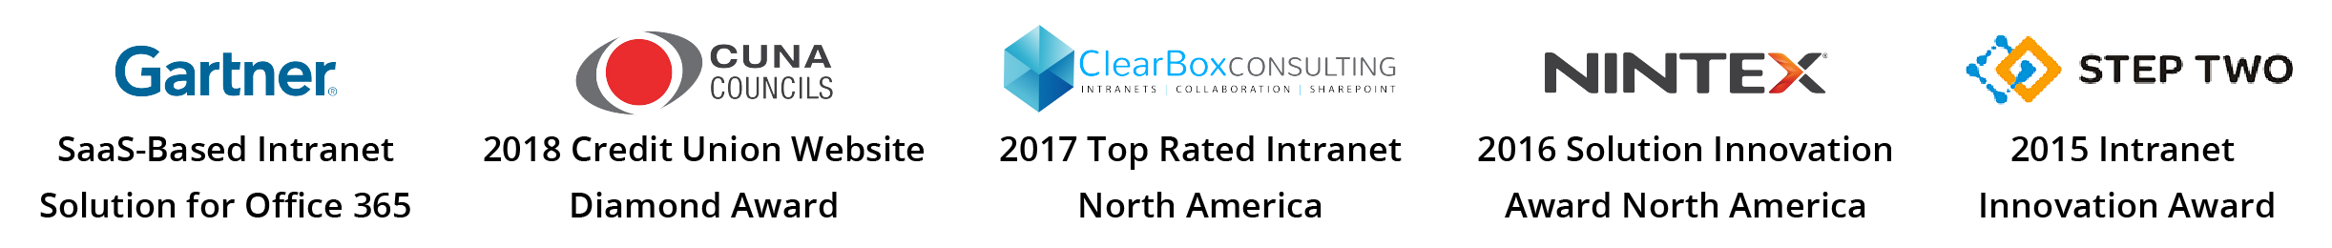
Michal Pisarek
Co-Founder of Dynamic Owl Consulting
Bonzai is a Vancouver-based award-winning intranet company
Bonzai delivers dramatically evolved, ready-to-roll intranets for SharePoint and Office 365.
We believe that intranets should better connect and engage employees, but not at the expense of a long, drawn-out and often failed custom deployment.
Michal is Product Director at Bonzai Intranet and a 6x Microsoft SharePoint MVP.
Introductions

Slide 6

What Makes a Great Intranet Team?

Mixtures of resources from various business areas​
​
Well understood and defined roles​
​
Adequate resourcing (you can’t perform miracles) ​
​
Has executive backing and support​
​
People that understand compromise​
​
A great Intranet vision






Slide 7
What’s the Best Approach for building the Ideal Intranet Project Team?

A great Intranet fulfills many roles and hence requires input from many functions!
A multi-disciplinary team is best for a holistic view of the intranet
Many hands can make light work
More engagement > more funding > more resourcing > the more you can do
What if just one department owns the Intranet?
Communications Owned Intranet
HR Owned
Intranet
IT Owned
Intranet:
Focus on News & Events
Homepage looks great
Missing key elements
Lots of self service capabilities
Great for HR content but weak on other content
Lots of bells and whistles
End users are not involved
Content is typically weak
http://bonzai-intranet.com/

Slide 8
What Size Should the Project Team be?
The Nielsen Norman Group have conducted fantastic research around intranet team sizes.
Interestingly, the number of members on winning intranet teams does not increase significantly between organizations with 100 employees and those with 500,000 employees.
According to the Nielsen Norman Group, the average team size from 2001 – 2018 was 14 members.
There is no right or wrong answer, but most organizations have between 5 – 14 people on their Intranet Team
The Nielsen Norman group have some great research on this
We have seen clients with very large teams have great Intranets but also clients with very small teams
Team size changes as you move from project to operational mode
For example, a Nielsen Norman award-winning organization had more employees than a fellow winner but had just two additional intranet team members.
http://bonzai-intranet.com/

Slide 9
Intranet Project Team Structure



Project Sponsor (1-2)
Project Manager (1)
Content Representatives (3-6)
Single or multiple people from the sponsoring department
Project sponsor doesn’t have to be involved day to day in the project but can if they want to
Many times, the sponsor comes from the Corporate Communications team as they are traditionally the owners of the Intranet
A great project sponsor should know enough about the project to communicate the goals and progress to other executives
Dedicated Project Manager to:
Liaise with Project Managers from vendor or other functional units within the organization
Ownership of client tasks and timeline
Ensure completeness of client deliverables
Ensure the necessary stakeholders are engaged
Representatives from core units representing key stakeholder departments.
Contributing substantial content to the intranet
Responsible for the implementation and ongoing operations of the intranet
With accountability / authority to make decisions regarding the intranet
Not all departments need to be represented. Other departments may be consulted and engaged at various stages as needed.
http://bonzai-intranet.com/

Slide 10
Key Recommendations

Recommended core team size (less than 9 people, 3 key decision makers), otherwise coordination or meetings and decision making may be challenging
Core project team representatives are different than the greater group of stakeholders (no need to involve every department on core project team)
Having a Content Strategist to work with the core team is beneficial
Core project team decision-making will require continual collaboration



http://bonzai-intranet.com/

Slide 11
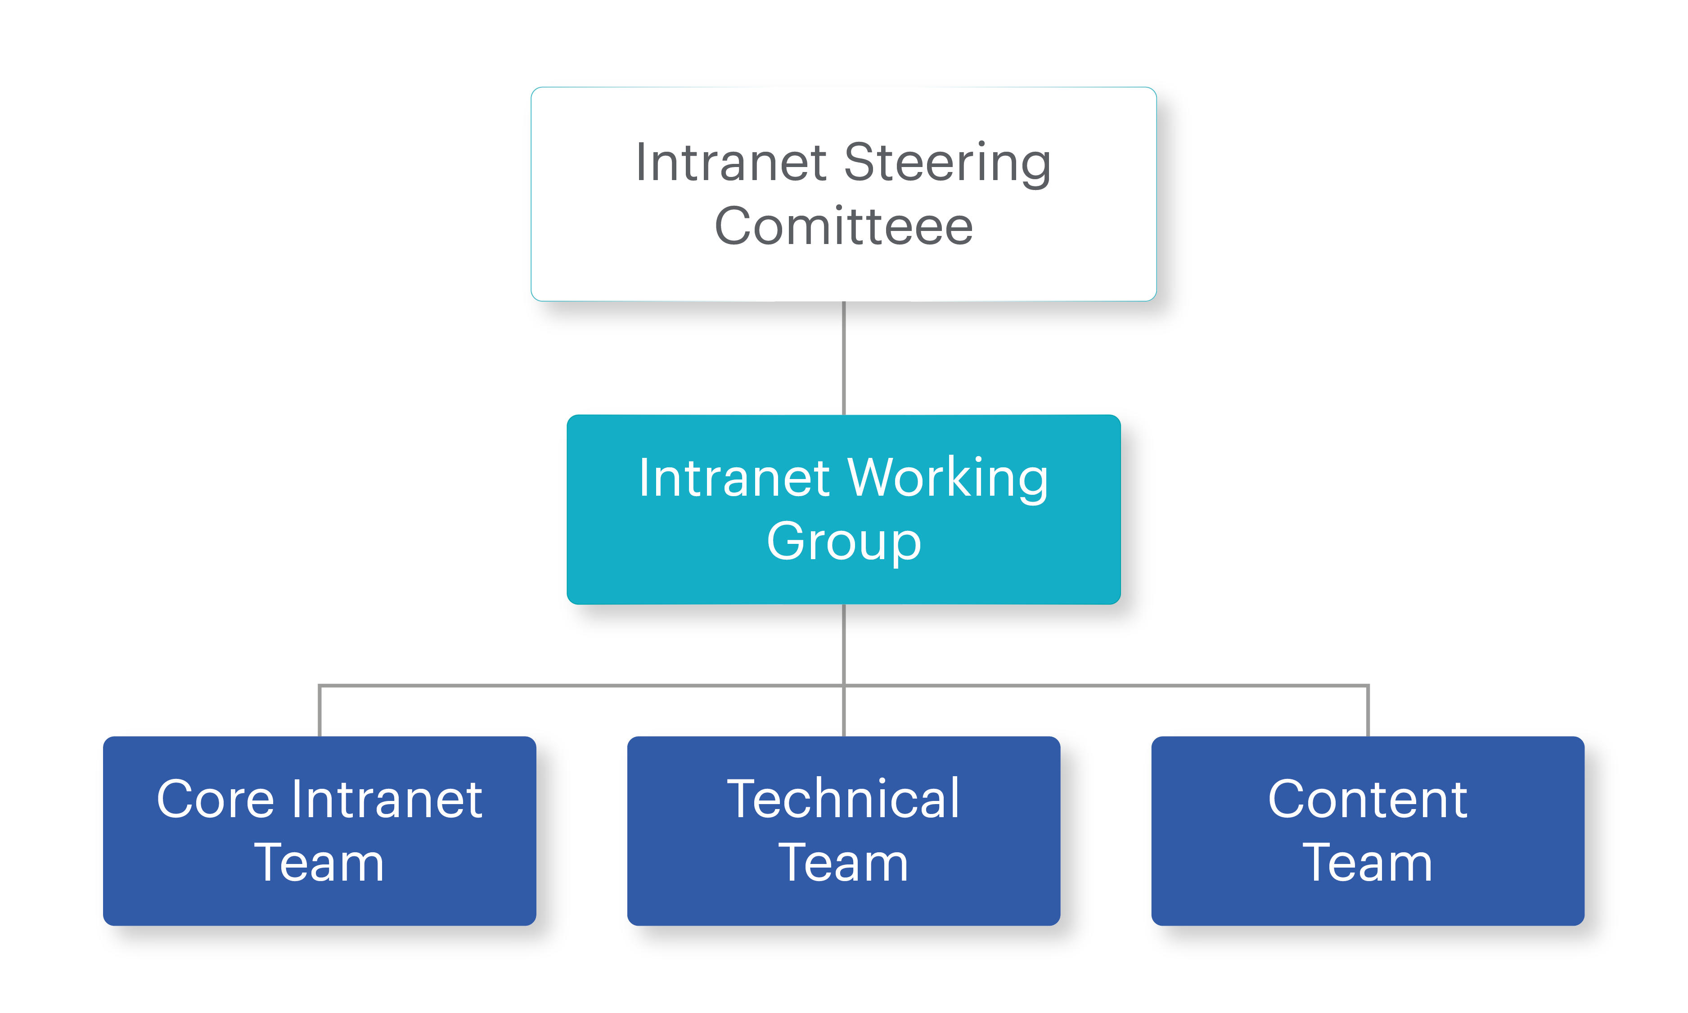
Intranet Team Operational Structure
Intranet Steering
Committee
Charged with maintaining the mandate of the Intranet
Typically has one or more executives that have significant clout in the organization
Should contain the Intranet Owner or Manager as a source of input
Must be able to provide financial support for further Intranet initiatives
Meets quarterly to discuss Intranet strategy, company strategy and alignment with goals
Between 3 – 8 people
http://bonzai-intranet.com/

Slide 12
Intranet Working Group
Responsible for the day to day management of the Intranet
Decides which features will be taken to the Steering Committee for funding
Between 4-8 people
Working Group Members
Intranet Owner
Technology Team
End User Advocate
Content Owners for larger sets of content (Comms, HR, Marketing, Operations)
Meets Monthly
Review Analytics and Usage Patterns
Review issues
Review end user feedback and feature requests
http://bonzai-intranet.com/

Slide 13
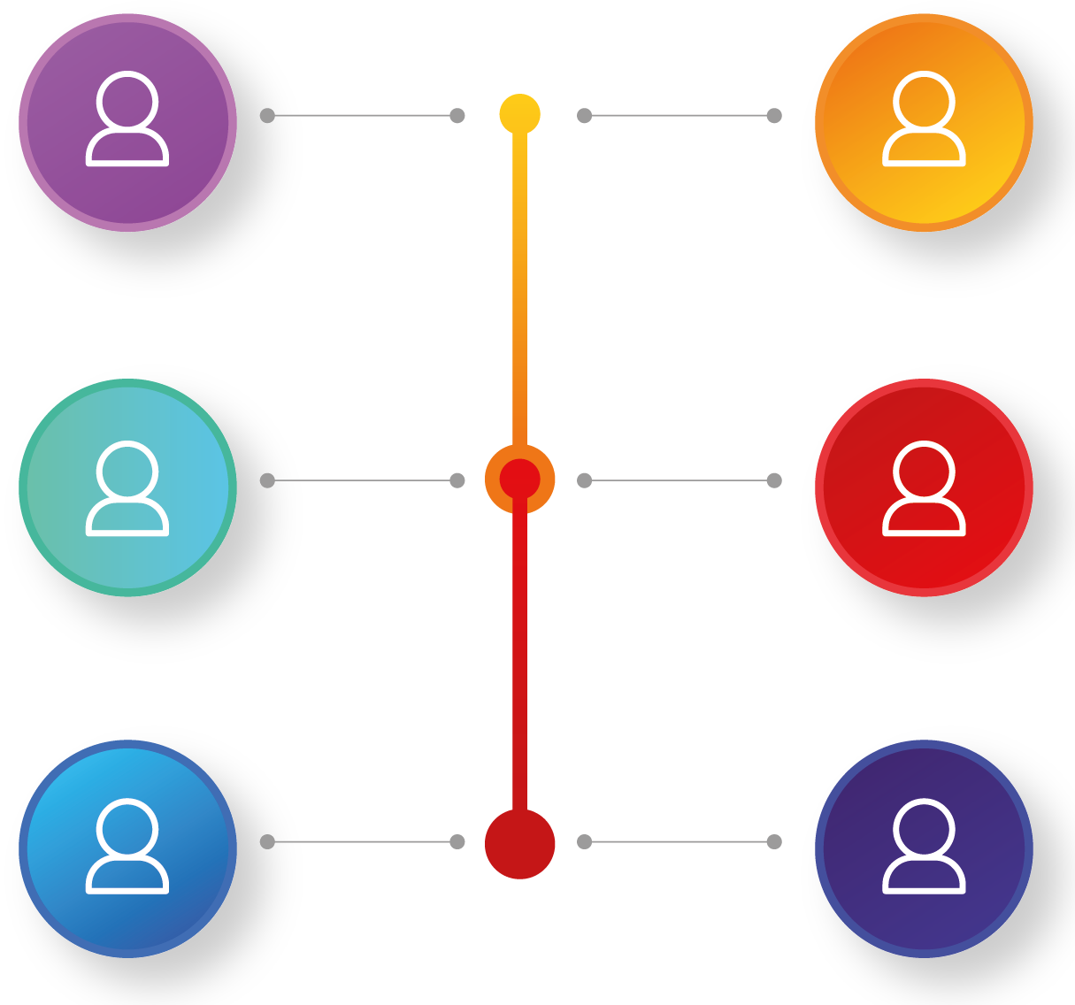
Intranet Content Team
Content
Authors
Subject Master
Experts
Content
Owners
Department or Functional Owners
Content
Approvers
Intranet
Users
http://bonzai-intranet.com/

Slide 14
Intranet Technical Team

section one

section one


section one

section one
Technical
Intranet
Owner
Active
Directory
Administrator
Tennant
or Farm
Administrator
Intranet
Developer
Platform
Owner
http://bonzai-intranet.com/

Slide 15
Intranet Core Team Roles & Responsibilities
Content Strategist
Description: This role will liaise with content owners in various Divisions and Departments to ensure that accurate and useful content is being published on the intranet.
Core Responsibilities:
Ensure that content is of a standard that provides business value.
Help in the content auditing activities of Intranet planning.
Search Administrator
Description: This role will ensure that search functions are at a level that provides benefits to the organization.
Core Responsibilities:
View search reports.
Create scopes, filters, refiners and search query rules.
Define metadata and taxonomy to drive search.
1
2
3
Project Manager
Description: The project manager is responsible for the ensuring that the Intranet is completed to scope, cost and time. Frequently the Project Manager is also instrumental in communicating and advocating the Intranet to the rest of the organization.
Core Responsibilities:
Liaise with various departments to get work done.
Ensure completeness of client deliverables.
Ensure the necessary stakeholders are engaged.
http://bonzai-intranet.com/

Slide 16
Intranet Core Team Roles & Responsibilities
4
Department or Area Owners
Description: Are responsible for content within a particular department or area. These users are the ultimate owners of content and functionality across a range of a site.
Core Responsibilities:
Own content and provide feedback to Intranet authors and approvers.
Ensure that content is up to standard.
Ask power users to make technical changes if necessary.
Power Users
Description: These users are responsible for more technical aspects of the Intranet including configuration, creation of new sites and advanced features that require a technical background.
Core Responsibilities:
Take requests from content authors and owners to make configuration changes on the site.
Provide feedback to the Intranet Owner about technical issue relating to the site.
Be responsible for configuring sites or functional areas on the Intranet.
5
http://bonzai-intranet.com/

Slide 17



About BONZAI
BONZAI, a SkyVera company, is an award-winning intranet company that provides ready-to-roll intranets for SharePoint and Office 365. As a Microsoft Certified Gold Partner, BONZAI intranet software and services deliver a better means of communicating, collaborating and engaging with employees for Fortune 500 Enterprise Organizations as well as SMBs.
At BONZAI, believe that intranets should better connect and engage employees, but not at the expense of a long, drawn-out and often failed custom deployment. With our proven delivery methodologies and seasoned intranet consultants with deep expertise into both Microsoft SharePoint and Office 365, Bonzai gets users through objective setting, design, ownership, launch/roll out and support in as little as eight weeks.

Slide 18
SharePoint Intranet with Business Sense
✶


www.bonzai-intranet.com
@bonzaiintranet sales@bonzai-intranet.com


+1 (604) 559 - 8070
401 Congress Avenue, Suite 2650, Austin, Texas 78701

